Slide 1



OFFICE ON POLICY PLANNING AND RESEARCH
INFORMATION AND COMMUNICATION TECHNOLOGY DIVISION

Slide 2
Design Prototypes
For The
Project Development Management
Information System (PDMIS)
Prepared By: Rey Jesus M. Teves
Information System Analyst I

Slide 3

INFORMATION AND COMMUNICATIONS TECHNOLOGY DIVISION
Project Development Management Information System (PDMIS)
The system will computerize the upload, download and input of Project Information submitted to NCIP

Slide 4
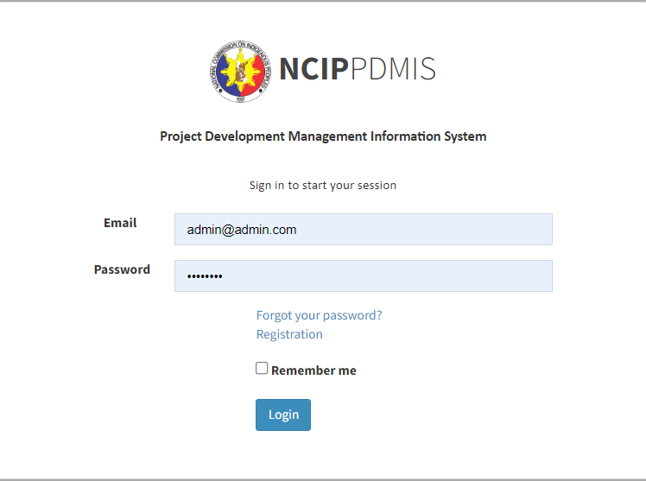
INFORMATION AND COMMUNICATIONS TECHNOLOGY DIVISION

Slide 5
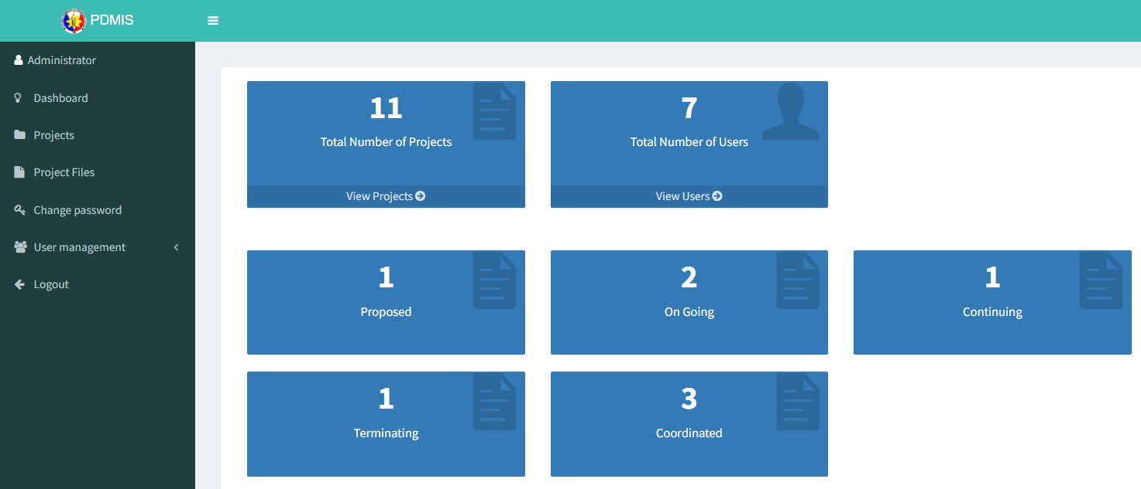
INFORMATION AND COMMUNICATIONS TECHNOLOGY DIVISION

Slide 6
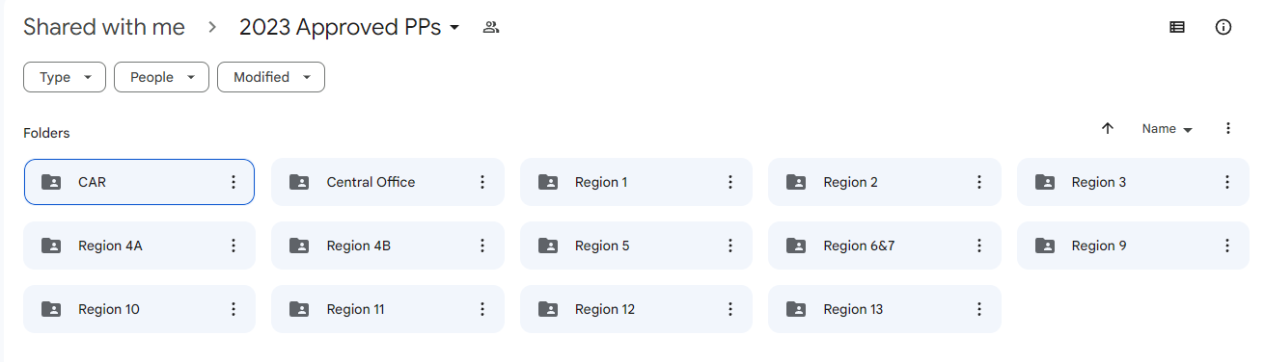
INFORMATION AND COMMUNICATIONS TECHNOLOGY DIVISION

Slide 7
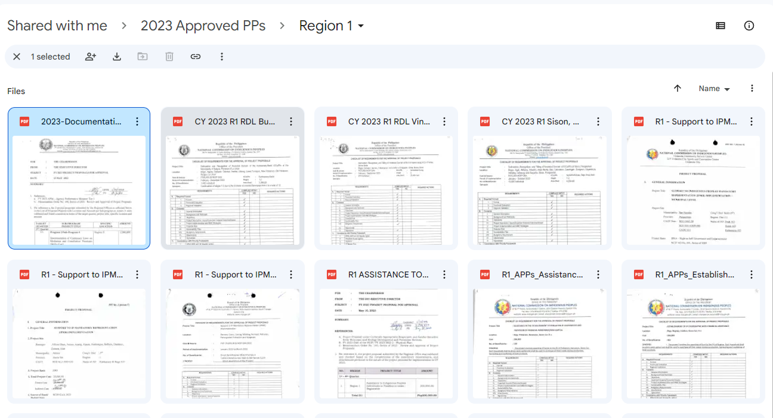
INFORMATION AND COMMUNICATIONS TECHNOLOGY DIVISION

Slide 8
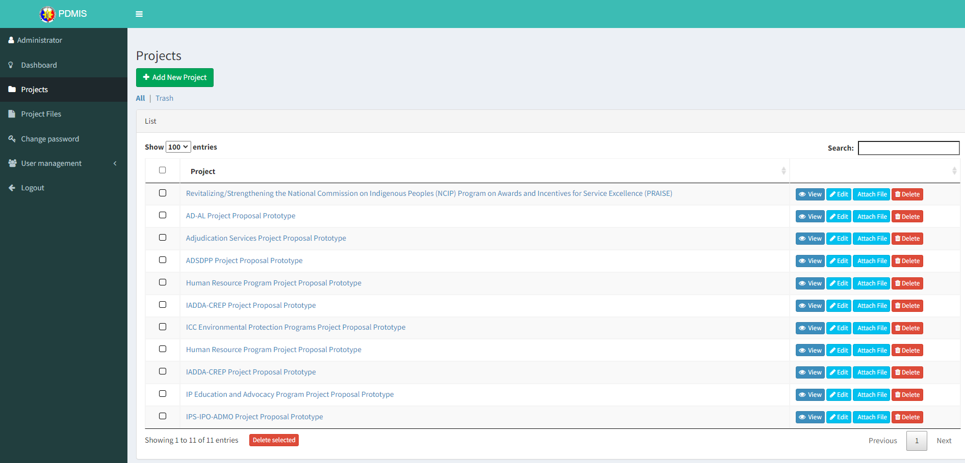
INFORMATION AND COMMUNICATIONS TECHNOLOGY DIVISION

Slide 9
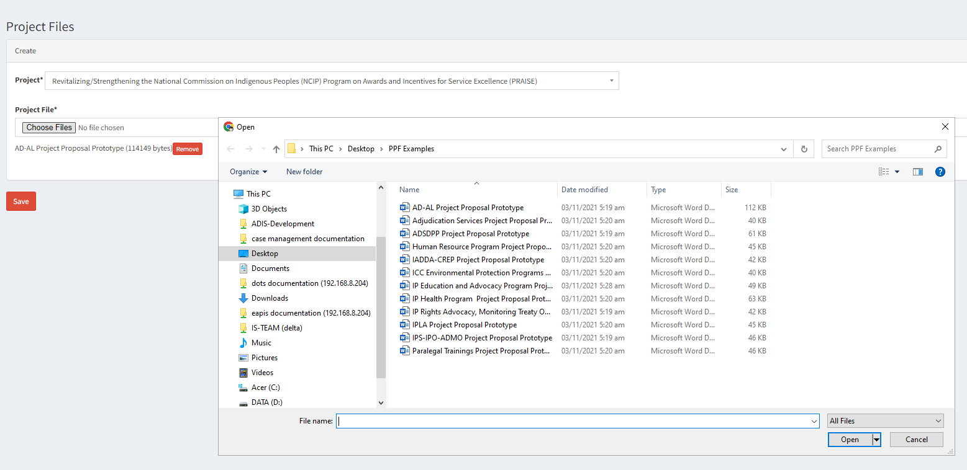
INFORMATION AND COMMUNICATIONS TECHNOLOGY DIVISION

Slide 10
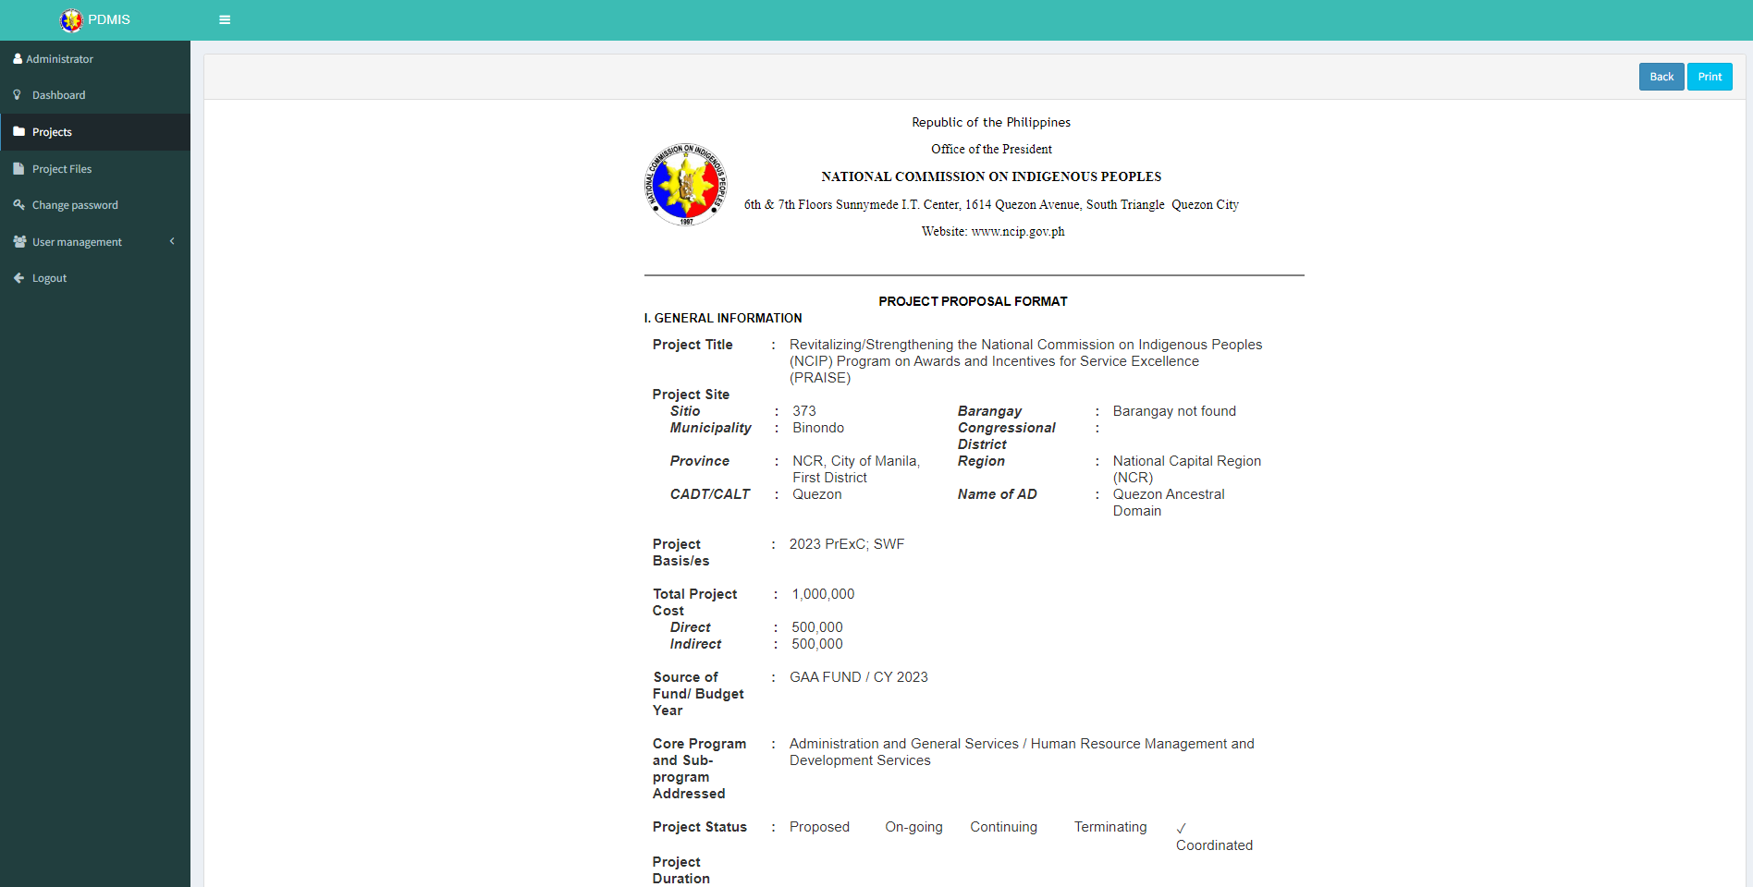
INFORMATION AND COMMUNICATIONS TECHNOLOGY DIVISION

Slide 11
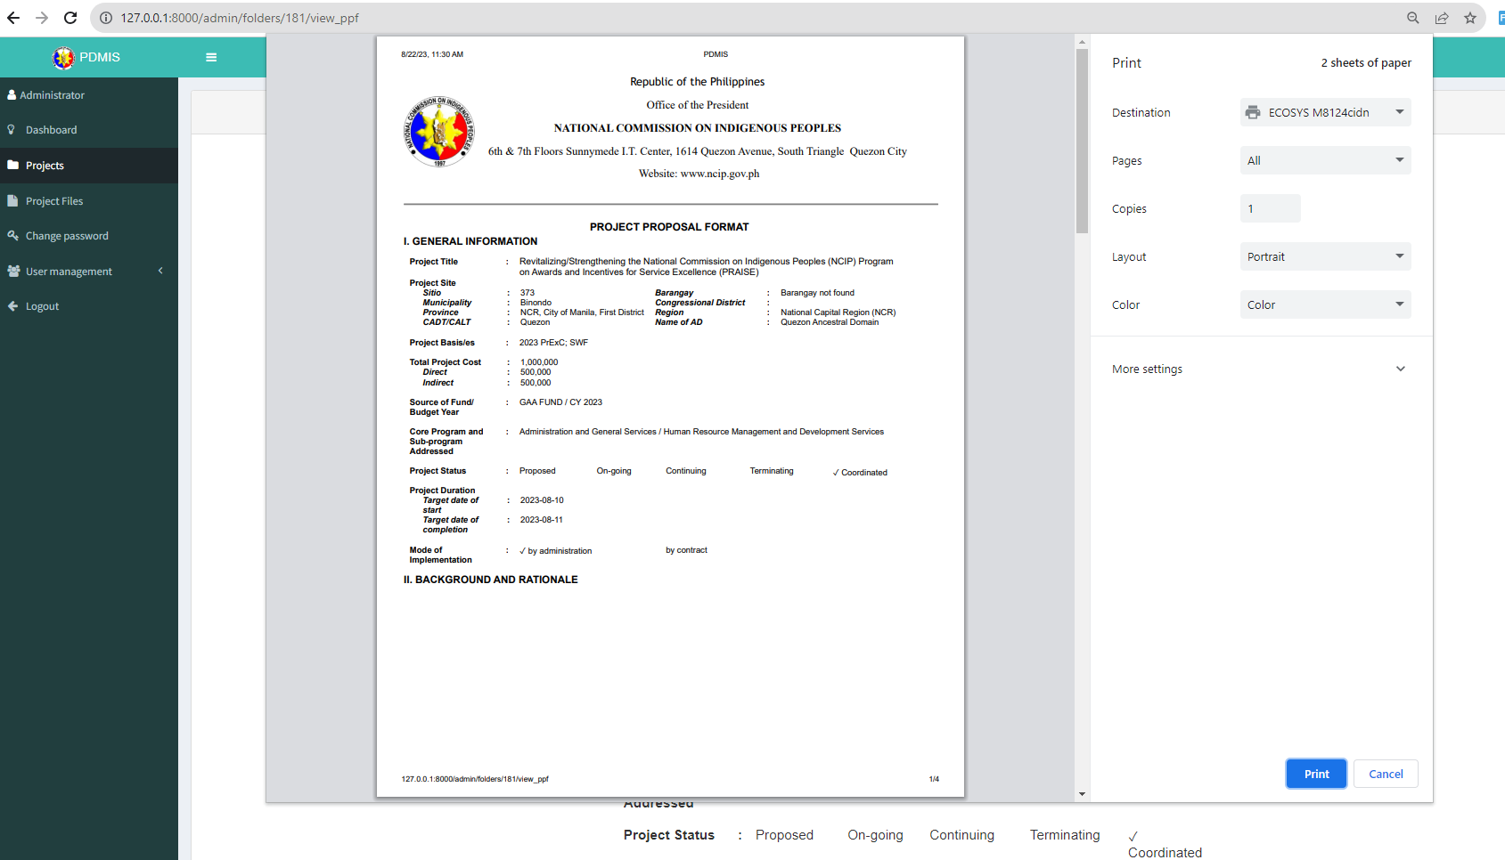
INFORMATION AND COMMUNICATIONS TECHNOLOGY DIVISION

Slide 12
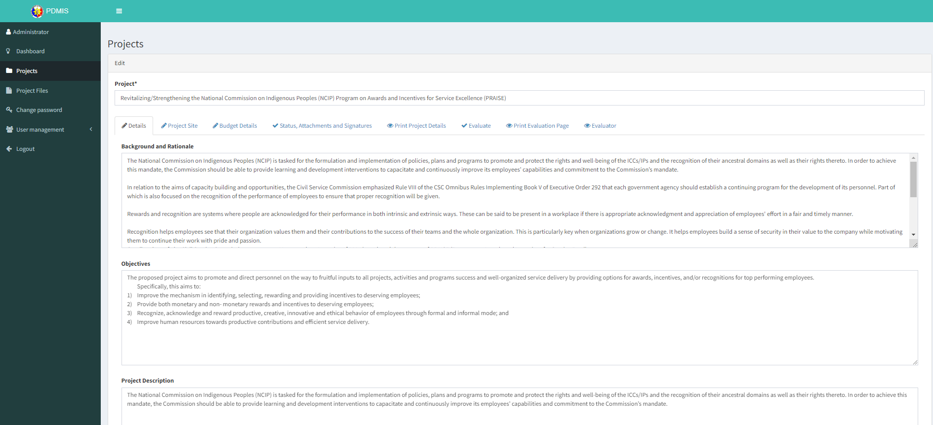
INFORMATION AND COMMUNICATIONS TECHNOLOGY DIVISION

Slide 13
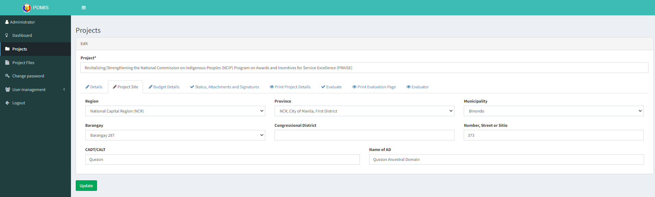
INFORMATION AND COMMUNICATIONS TECHNOLOGY DIVISION

Slide 14
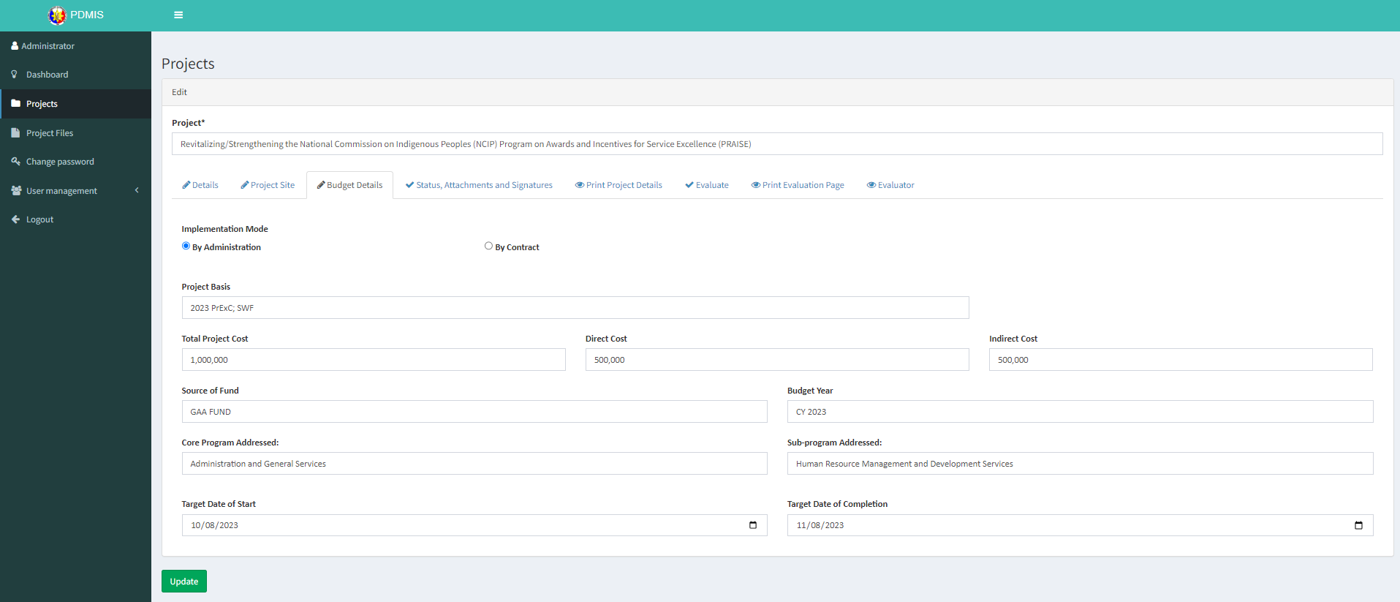
INFORMATION AND COMMUNICATIONS TECHNOLOGY DIVISION

Slide 15
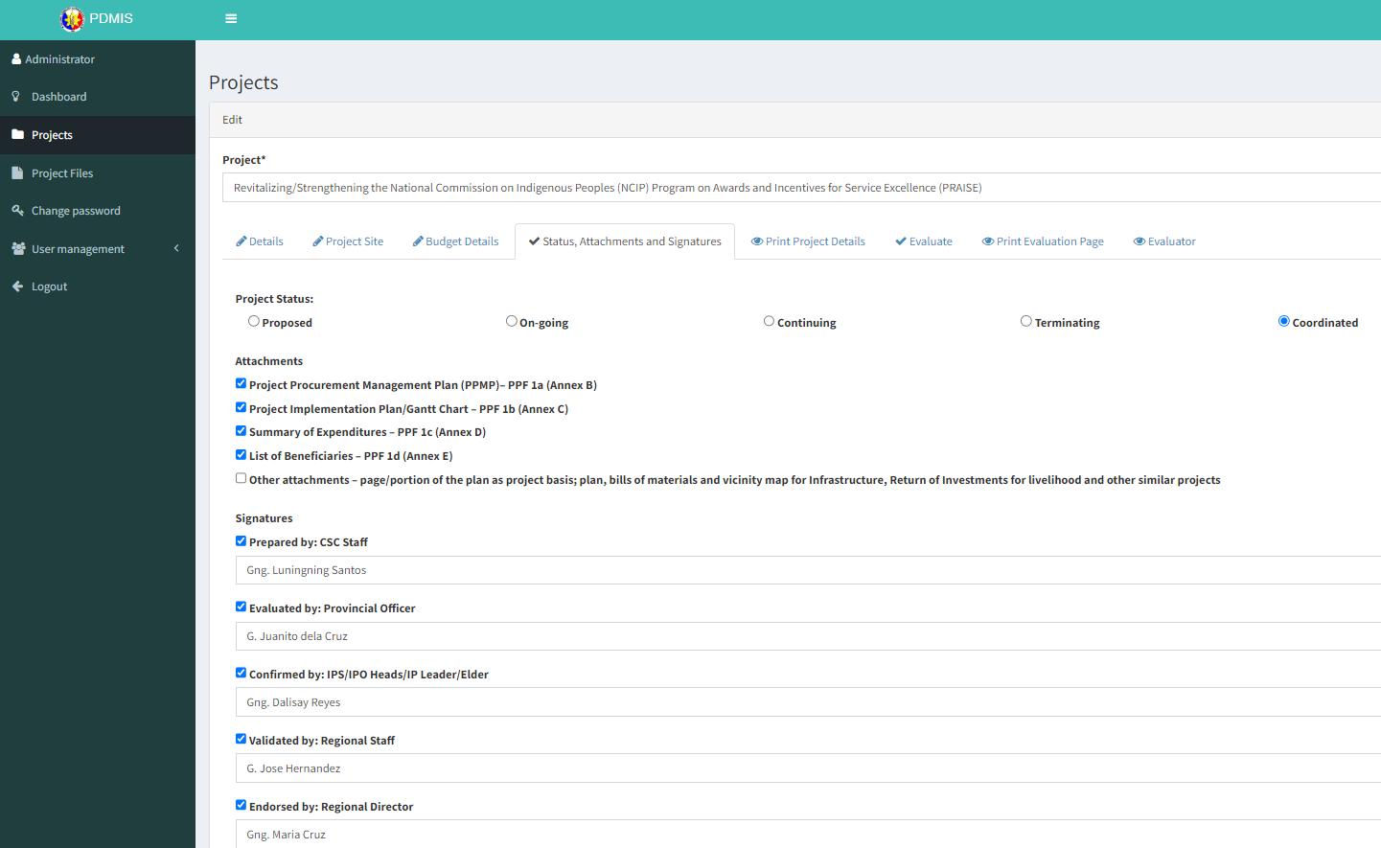
INFORMATION AND COMMUNICATIONS TECHNOLOGY DIVISION

Slide 16
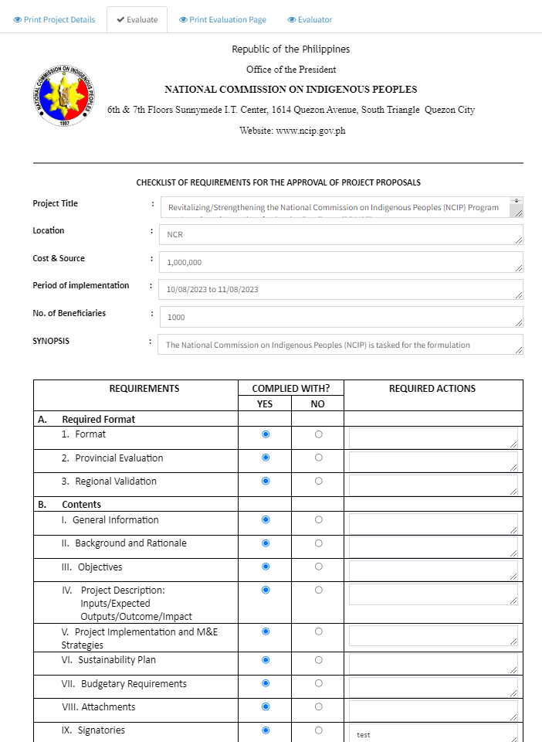

Slide 17
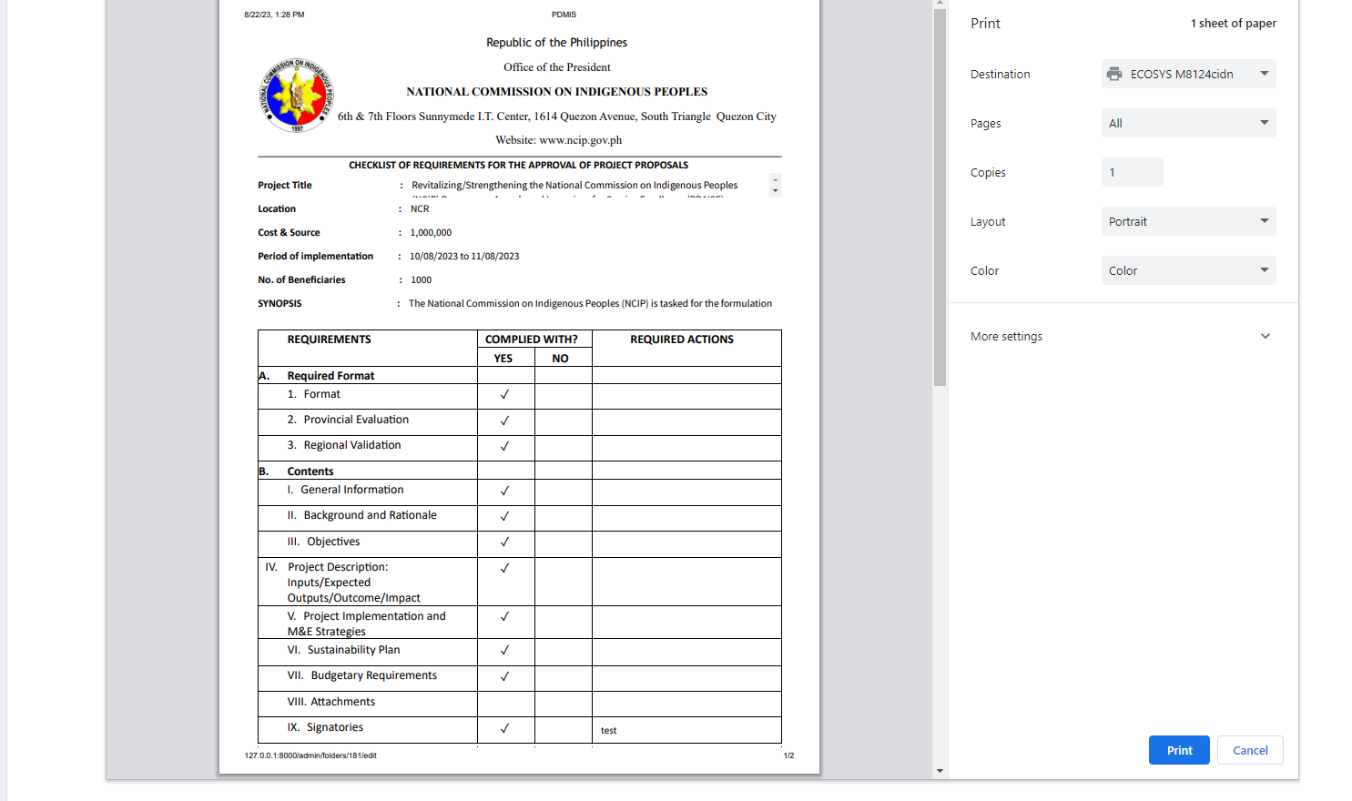

Slide 18
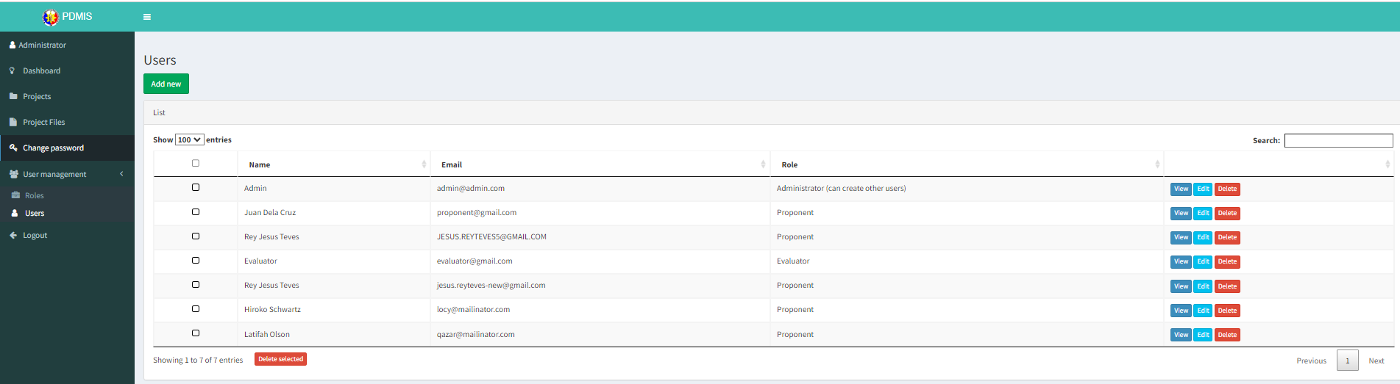
INFORMATION AND COMMUNICATIONS TECHNOLOGY DIVISION

